Slide 1

How we did it and what we learned
By while true

Slide 2
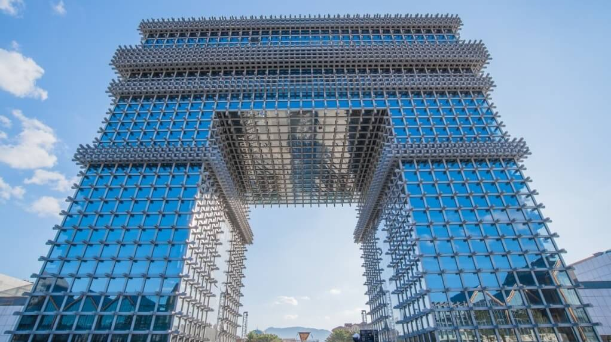
Defining the structure

Slide 3
Lexer
Parser
CG
Linker

Slide 4

Restrospective

Slide 5

The good

Slide 6

The bad

Slide 7

In conclusion

